Slide 1

Fuzzy Logic and its Applications Seminar Presentation
Presented By: Armaan Dhillon
Roll No: 12114058

Slide 2
What is Fuzzy Logic?
Fuzzy logic is a computational paradigm that mimics human reasoning to deal with uncertain or imprecise information. Unlike binary logic, which assumes everything is either true (1) or false (0), fuzzy logic assigns a degree of truth between 0 and 1.
Example:
Is the water temperature hot?
Classical Logic: Yes (1) or No (0).
Fuzzy Logic: It’s “somewhat hot” (0.7).

Slide 3
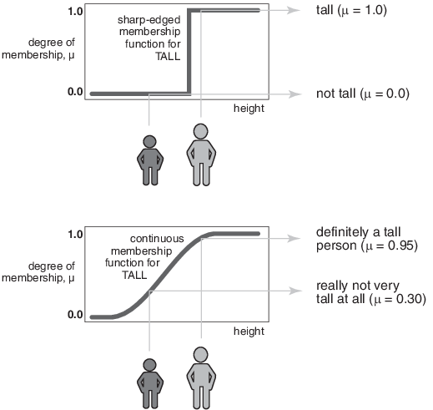
Different from Traditional logic:

Slide 4
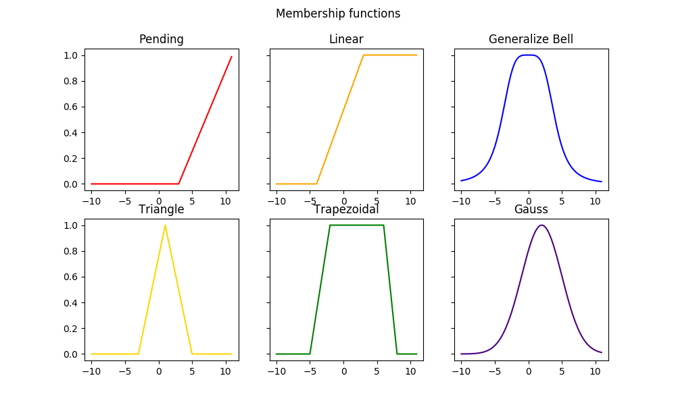
Different Membership Functions:

Slide 5
Key Characteristics:
Non-binary: Allows values between 0 and 1.
Human-like Reasoning: Handles vague or incomplete data.
Linguistic Variables: Works with terms like "high," "low," "medium" instead of exact numbers.

Slide 6
Why Fuzzy Logic?
Challenges with Traditional Logic:
Cannot handle uncertainty or vagueness.
Inflexible in systems requiring human-like decision-making.
Why Fuzzy Logic is Better:
Tolerance for Imprecision: Deals well with vague inputs.
Smooth Transitions: Avoids abrupt jumps between categories.
Wide Applicability: Used in systems requiring adaptability and reasoning.

Slide 7
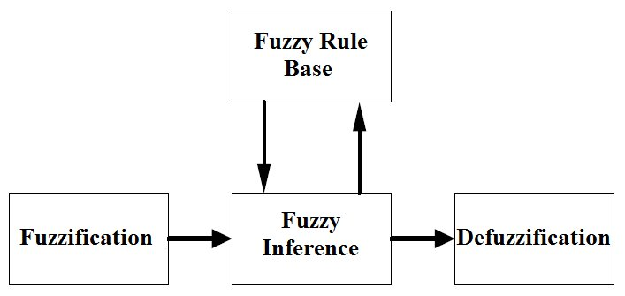
Basic fuzzy structure

Slide 8
Tipper Problem for Fuzzy Logic
The tipper problem models a real-world scenario where a restaurant patron decides how much to tip based on the quality of service and food.
This decision-making process is subjective and can vary from person to person, making it an ideal example for fuzzy logic.

Slide 9
Why Traditional Logic Fails in the Tipper Problem:
Rigid Boundaries:
Traditional (crisp) logic relies on strict thresholds. For example:
Service score < 5 → Poor
Service score ≥ 5 → Good
This rigid classification cannot handle the smooth transitions between "poor" and "good." A service score of 4.9 is treated vastly different from 5, which is unrealistic for subjective scenarios.
Lack of Flexibility:
Adding more variables (e.g., ambiance or group size) requires a rigid increase in conditions, leading to an explosion of rules and complexity in traditional logic.

Slide 10
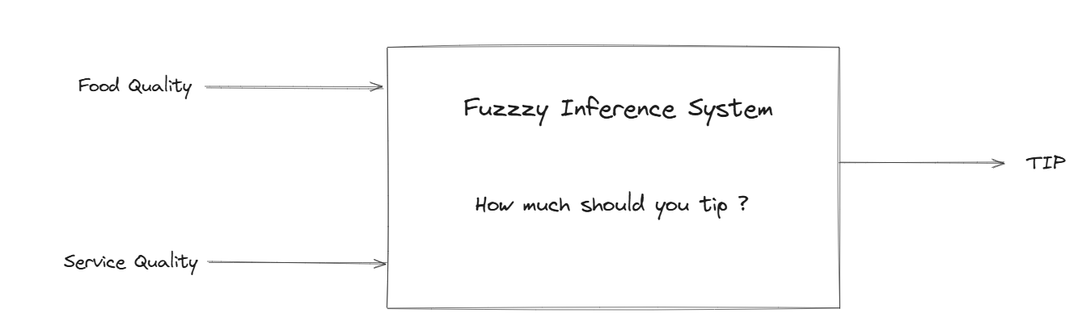
Inputs: Service quality (poor, average, good) and food quality (rancid, delicious).
Output: Tip amount (low, medium, high).
Challenge: Translate these subjective descriptors into a mathematical model to calculate the tip.

Slide 11
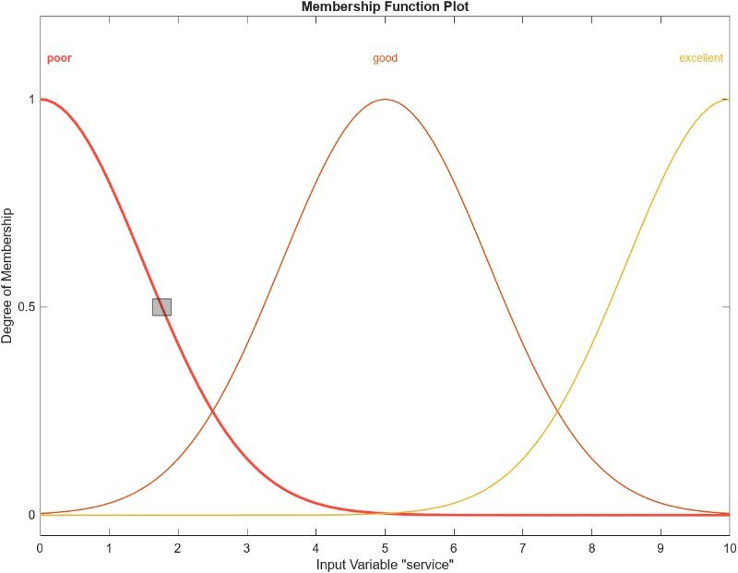
Steps in Solving the Tipper Problem:
Fuzzification:
Define fuzzy sets for inputs and outputs:
Service quality:
Poor (0–5)
Good(3–7)
Excellent(7-10).

Slide 12
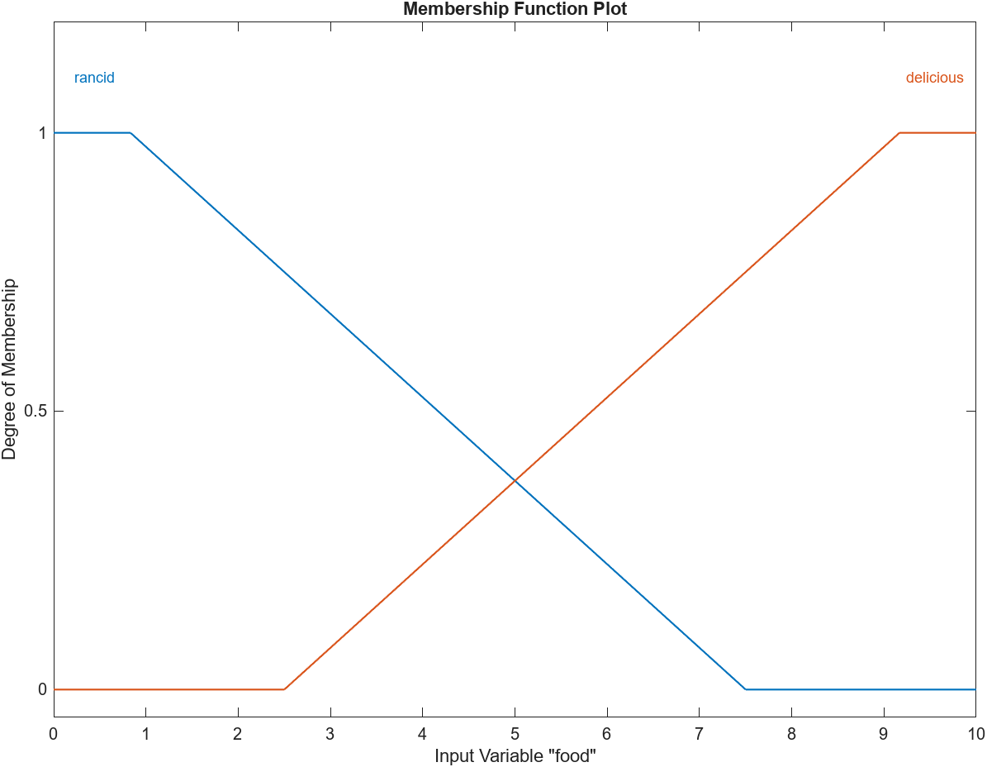
Membership Functions for Food Quality:
Food quality: rancid(0–5), Delicious (5–10).

Slide 13
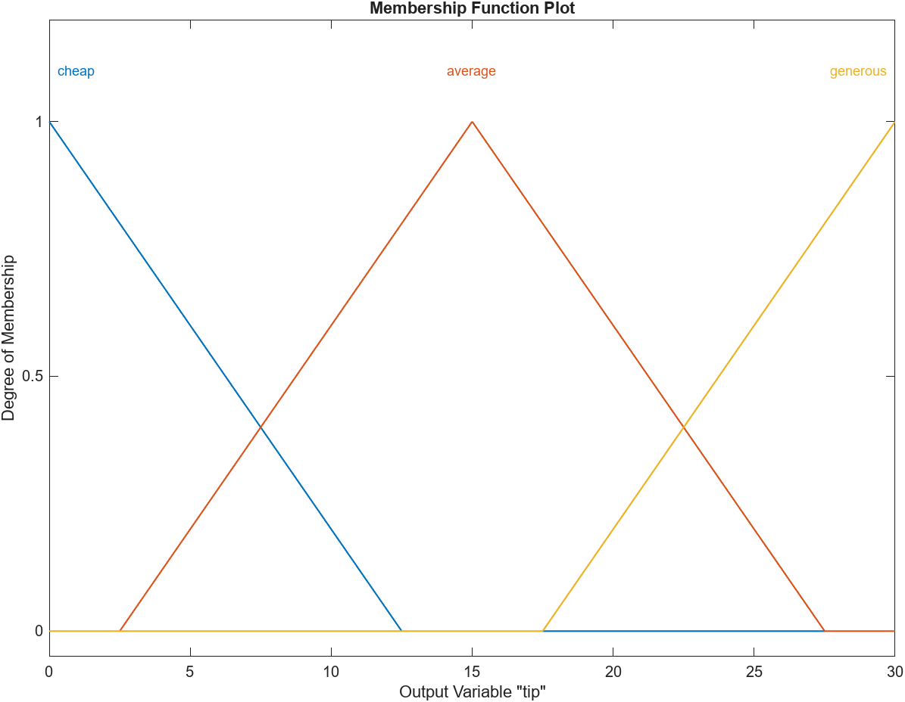
Output Membership Functions :
Tip amount: cheap(0–10%), average(10–15%), generous(15–20%).

Slide 14
Rule Base:
Rule 1: If service is poor or food is rancid, then tip is cheap.
Rule 2: If service is good, then tip is average.
Rule 3: If service is excellent or food is delicious, then tip is generous.

Slide 15
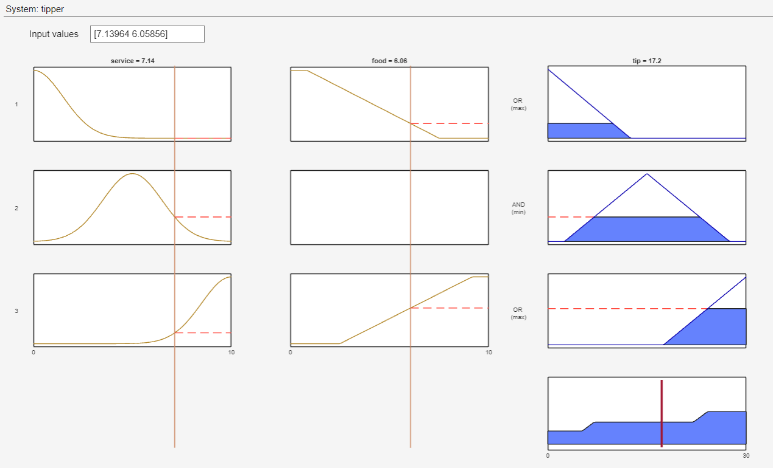

Slide 16
Advantages of Fuzzy Logic
Captures human-like reasoning for subjective decisions.
Easy to expand by adding more rules and inputs (e.g., ambiance).
Industrial automation.
Healthcare and diagnostics.

Slide 17
Disadvantages of Fuzzy Logic
Rule Explosion:As the number of inputs increases, the number of rules required can grow exponentially, leading to a "combinatorial explosion." This makes the system harder to manage and increases computational requirements.
Limited Learning Capability:Unlike machine learning algorithms, traditional fuzzy systems do not learn from data. Any updates require manual adjustment of rules and membership functions.
Dependence on Expert Knowledge:The quality of a fuzzy system depends heavily on the availability of expert knowledge to define accurate rules and membership functions.

Slide 18
Future trends of fuzzy logic
Fuzzy Control Systems: Advances in automation and robotics will rely more on fuzzy logic for adaptive, precise control systems.
Hybrid Optimization: GA and fuzzy logic are being combined for multi-objective optimization problems, where GAs optimize parameters and fuzzy logic handles uncertain or imprecise data, especially in complex systems like robotics, manufacturing, and AI.

Slide 19
References:
L. A. Zadeh, “Fuzzy sets,” Information and Control, 1965.
M.G.Voskoglou,“Methods for assessing human–machine performance under fuzzy conditions,” Mathematics, vol. 7, no. 3, p. 230, 2019.
MathWorks, Fuzzy Logic Toolbox User’s Guide, The MathWorks [Online]. Available: https://www.mathworks.com/help/fuzzy.

Slide 20
Thank You

